Slide 1
Theory of the firm: Managerial behavior, agency costs and ownership structure
Jensen and Meckling, JFE, 1976
Youngsir Rha
BADM 549

Slide 2
Objective and Summary
Previously, there was no established theory of firms. A firm was treated like a “black box.”
This paper develops a theory of the ownership structure of the firm by integrating the theory of agency, property rights, and finance.
Ownership structure: how is firm financing done through debt or equity markets? (ratio)
Explains ownership structure of the firm as an institution designed to limit (minimize) agency costs.

Slide 3
New definition of the firm
“Just like any organizations or institutions, a firm is a form of legal fiction which serves as a nexus for contracting relationships among individuals.”
The firm is not an individual. It is a legal fiction that brings the conflicting objectives of individuals into equilibrium via contracts.
Thus, the “behavior” of a film is like that of a market, not a person with motivations and intentions.

Slide 4
Theory of property rights
Theory of property rights
Theory of agency
equity
Theory of corporate ownership structure
debt
Coase, Alchain, Demsetz
Specification of individual rights via contracts determines how costs and reward will be allocated among the participants in an organization. So individual behavior will depend upon the nature of these contracts.
This paper focuses on the behavioral implications of the property rights in the contracts between the owners and managers of the firm.

Slide 5
Theory of agency
Theory of property rights
Theory of agency
equity
Theory of corporate ownership structure
debt
Adam Smith, The Wealth of Nations (1776): “the managers of a firm are agents who manage money of others, so they may exhibit negligence and profusion.”
Agency relationship is a contract under which one or more persons (principals=shareholders) engage another person (agent=manageres) to perform some service on their behalf via delegation of decision-making authority.
Because both principals and the agent are utility maximizers, the agent will not always act in the best interests of the principal.
The principal will establish incentives for the agent and incur costs (monetary and non-monetary) such as monitoring costs by the principal, bonding costs by the agent, and residual loss. (NB: monitoring includes rewards and routines) → The sum of these three costs= agency costs.
Notes:
Utility maximizers: The analysis retains this notion
Residule costs: the dollar equivalent of the reduction in welfare experienced by the principal due to the divergence between agent and principal.
Agency costs also arise even when there is no agency relationship. e.g. cooperative project. → similar to “shirking” and “monitoring” from Alchain and Demsetx (1972)

Slide 6
Theory of agency: Focus of this paper
Theory of property rights
Theory of agency
equity
Theory of corporate ownership structure
debt
Investigates the incentives faced by the parties and elements of determination of the equilibrium contractual form that characterizes the relationship between the agent and the outside equity and debt holders (principals)
Conflicting objectives of individuals of a firm are brought into equilibrium through contracts
Most firms have a mixed financial structure, employing both outside equity and debt (mixed financial structure)
Agency costs are generated by outside claims of the firm 1) outside equity 2) debt

Slide 7
Agency costs of outside equity
Theory of property rights
Theory of agency
equity
Theory of corporate ownership structure
debt
CASE 1: Wholly owned firm managed by owner
The manager (=owner) owns 100% of the residual claims on a firm.
The manager will make decisions that maximize her own utility (both pecuniary and non-pecuniary).
the optimum mix (in the absence of taxes) of the pecuniary and non-pecuniary utilities (benefits) is achieved when the marginal utility from an additional dollar of expenditure is equal for each non-pecuniary item and equal to the marginal utility from an additional dollar of after-tax purchasing power (wealth)
CASE2: Owner-manager sells equity to outside shareholders
divergence between two parties’ interests will incur agency costs.
If the manager owns 95% of the stock, he will expend resources until the marginal utility from 1 dollar of expenditure equals the marginal utility of an additional 95 cents in general purchasing power (his share of wealth reduction), and not one dollar.
As the owner-manager’s fraction of the equity falls, he will be encouraged to spend more resources. Also, the minority shareholders will expend more resources for monitoring the manager’s behavior
Thus, the wealth costs to the owner of obtaining additional cash in equity markets rise as his fractional ownership of the firm’s wealth fails.
Notes:
non-pecuniary utility: physical appointments of the office, attractiveness of the secretarial staff, level of employee discipline, charitable contributions, personal relations (love, respect) with employees, etc.

Slide 8
Theorem: How does it affect agency costs?
Theory of property rights
Theory of agency
equity
Theory of corporate ownership structure
debt
In the case the owner-manager takes a proportion (a) of the firm’s value,
For a claim on the firm of (1-a), the outsider will pay only (1-a) times the value he expects the firm to have, given the induced change in the behavior of the owner-manager. → The agent (manager) bears the agency costs of equity
Why? In selling equity shares, prospective buyers will realize the agency problem makes the shares worth less and will pay less for them. They will consider the firm's value given the new ownership structure. So, it is in the agent's interest to devise a contract that limits the agency costs of equity.
Notes:
induced change: like explained above, the owner will increase his non-pecuniary consumption when his ownership share is reduced.
who bears the cost is important in later section where the paper integrates the concepts of outside equity and debt into a theory of corporate ownership.
the price for shares that shareholders will pay reflects the monitoring costs and the effect of the divergence between them and the manager. The owner will be willing to bear these costs as long as the welfare increment is large enough to offset them.
Agency costs vary across firms with: manager's taste, monitoring and bonding costs, cost of measuring performance, cost of designing incentive contract, cost of replacing management

Slide 9
Bottom line
Theory of property rights
Theory of agency
equity
Theory of corporate ownership structure
debt
Agency cost is non-zero (there are costs related to the separation of ownership and control)
Agency relationship is non-optimal
The first-best world is not obtainable
A manager in a firm will choose a (second-best) set of activities for the firm so that the total value of the firm is LESS than it would be if he/she were the sole owner. This outcome is independent of whether the firm operates in monopolistic or competitive product markets.

Slide 10
Agency costs of debt
Theory of property rights
Theory of agency
equity
Theory of corporate ownership structure
debt
Having the manager become the sole equity holder will not incur agency costs associated with outside equity.
But why don’t we observe large corporations individually owned with a tiny fraction of the capital supplied by the entrepreneur in return for 100 % equity and the rest simply borrowed?
(1) Incentive effects
If the investment turns out well, the manager captures most of the gains. If the investment fails, the creditors bear most of the costs.
→ Insulates the manager from the full impact of decisions. limits their losses in bad scenarios.
Incentive effects associated with debt: owner-managers have a strong incentive to engage in excessive risk-taking (risky investments).

Slide 11
Agency costs of debt (Cont’d)
Theory of property rights
Theory of agency
equity
Theory of corporate ownership structure
debt
(2) Monitoring and bonding costs
Can devise provisions to protect the bondholders from incentive effects.
But there are costs of writing incredibly detailed provisions and costs of enforcing them. → “Monitoring costs”
Monitoring costs are imposed on the owner-manager. Thus, it is in his interest to find a way to do monitoring at the lowest cost. Bondholders may use financial statements as a means of monitoring. Managers can provide bondholders with this information at a lower cost. The cost of providing this information is called “Bonding costs”
“Collateral” is another example of bonding.

Slide 12
Agency costs of debt (Cont’d)
Theory of property rights
Theory of agency
equity
Theory of corporate ownership structure
debt
(3) Bankruptcy and reorganization costs
This is why debt doesn’t completely dominate capital structures.
It is costly to write contracts representing claims on a firm regarding bankruptcy
Bankruptcy is not costless because it involves an adjudication process that consumes some of the remaining value of the firm assets.
Reorganization costs: legal and professional fees and expenses

Slide 13
Who bears the agency costs of debt?
Theory of property rights
Theory of agency
equity
Theory of corporate ownership structure
debt
The owner-manager bears the entire wealth effects of the agency costs of debt and he capture the gains from reducing them. (same as agency costs of outside equity)
Thus, agency costs from debt discourage the use of corporate debt.
What encourages the use of debt? Tax subsidy on interest payments.

Slide 14
A theory of the corporate ownership structure
Theory of property rights
Theory of agency
equity
Theory of corporate ownership structure
debt
Integrates the concepts of outside equity and debt into the theory of corporate ownership. ← “ownership structure” highlights the fraction of the equity held by the manager.
Three variables to be determined about a firm: 1) inside equity (held by the manager) 2) outside equity (held by any outsiders) 3) debt (held by outsiders)

Slide 15
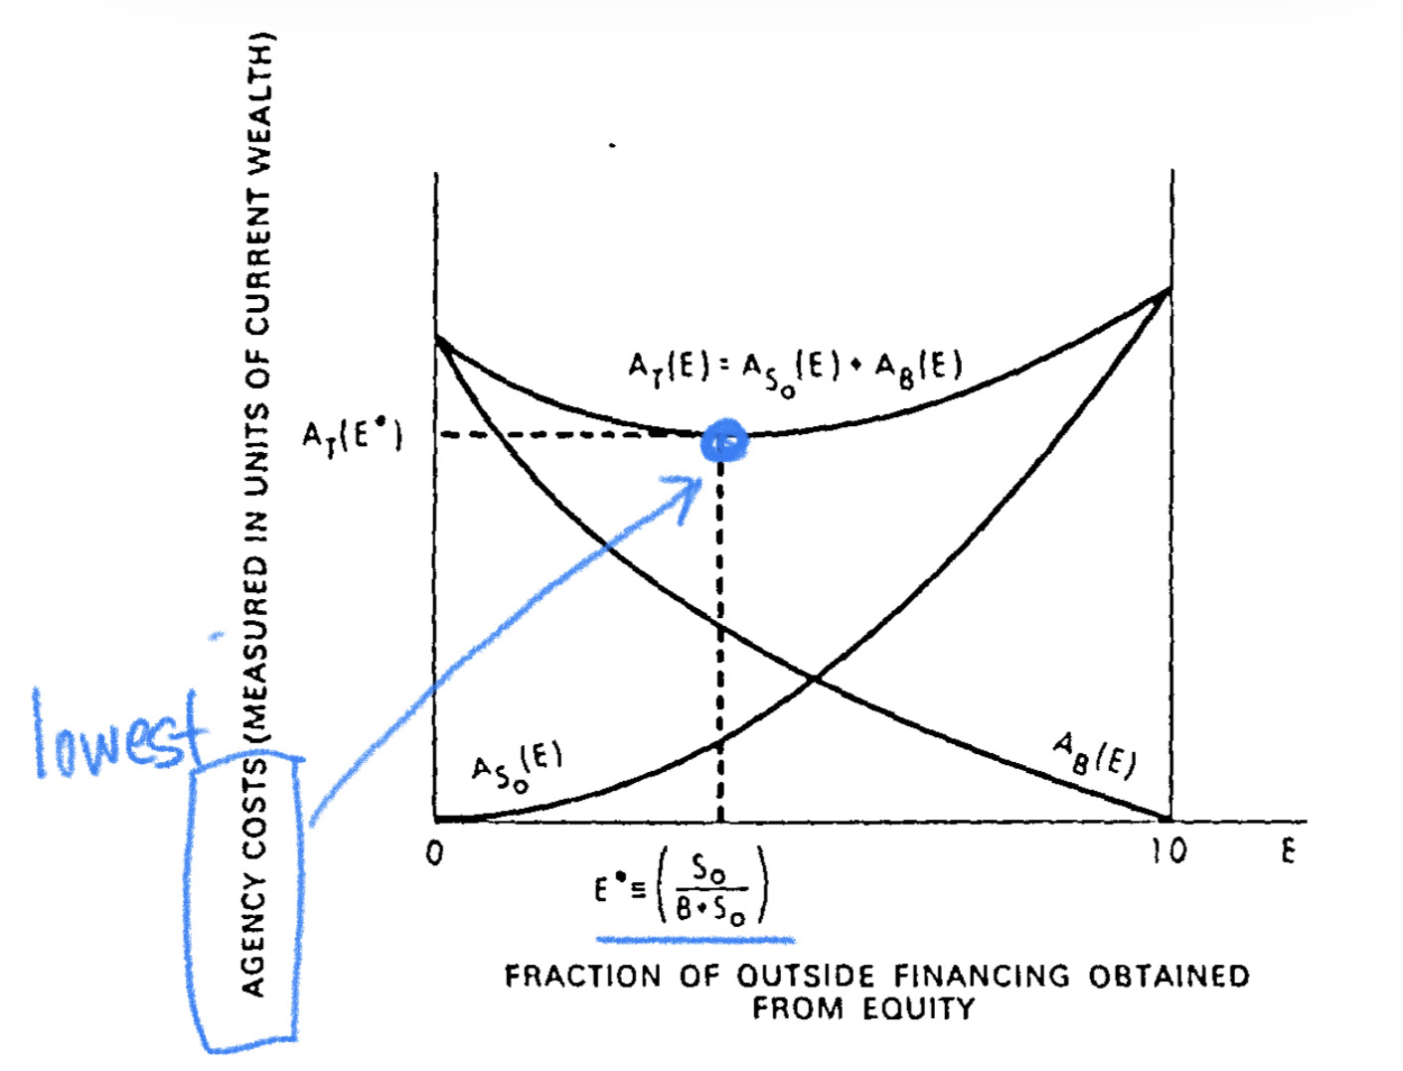
Optimal ratio of outside equity to debt: 2/(2+3)
Theory of property rights
Theory of agency
equity
Theory of corporate ownership structure
debt
Three variables to be determined about a firm: 1) inside equity (held by the manager) 2) outside equity (held by any outsiders) 3) debt (held by outsiders)
Retains the arguments that 1) in an efficient market, prices of debt and outside equity will reflect unbiased estimates of monitoring costs and redistributions which the agency relationship engenders, and 2) the selling owner-manager will bear these agency costs.
Therefore, from the owner-manager’s standpoint, the optimal proportion of outside funds to be obtained from equity compared to debt for a given level of internal equity is the one that results in minimum total agency costs.
→ explains ownership structure of the firm as an institution designed to limit agency costs.

Slide 16
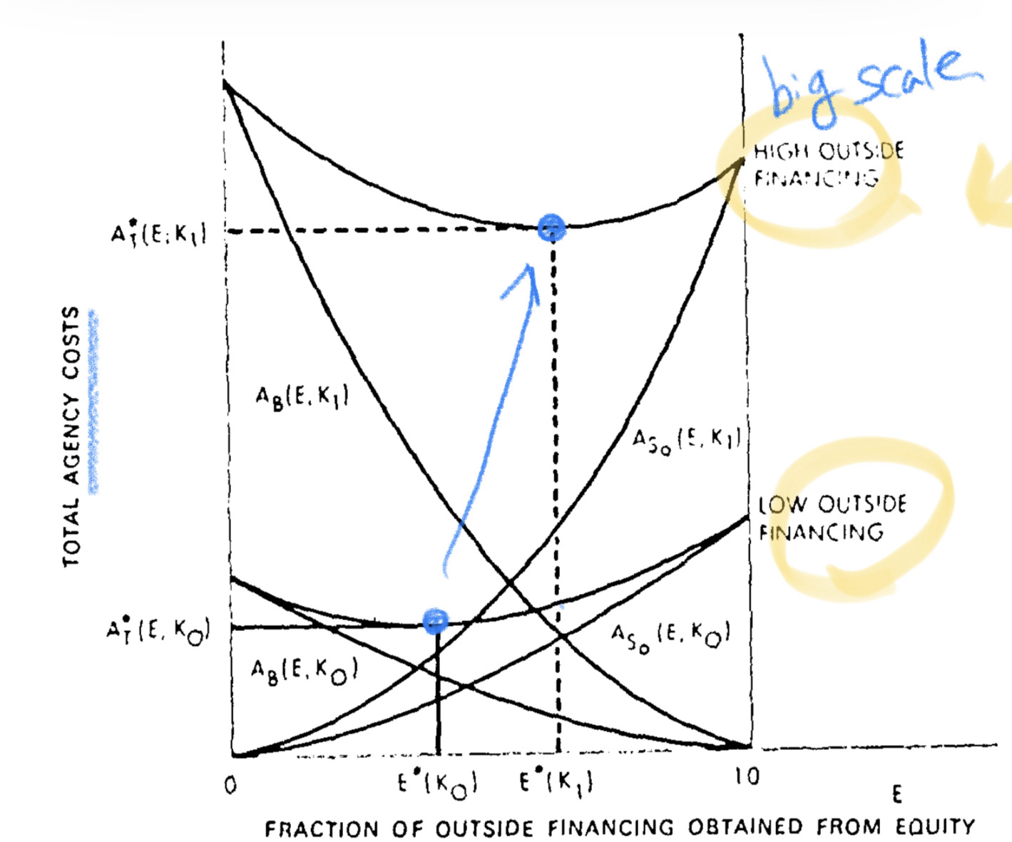
Effects of the scale of outside financing: 2+3
Theory of property rights
Theory of agency
equity
Theory of corporate ownership structure
debt
Three variables to be determined about a firm: 1) inside equity (held by the manager) 2) outside equity (held by any outsiders) 3) debt (held by outsiders)
The larger the firm becomes (big scale outside financing), the larger are the total agency costs because it is likely that the monitoring function is inherently more difficult and expensive in a larger organization.

Slide 17
Risk and the demand for outside financing
Optimal amount of outside financing
Theory of property rights
Theory of agency
equity
Theory of corporate ownership structure
debt
anagers who are risk-averse will practice diversification and portfolio management and become a minority stockholder of the firm he manages.
Determined by the intersection between the demand by the manager for outside financing (marginal value of the increased diversification) and marginal agency cost
.
A Pareto optimal choice: there is no way to reduce agency costs without making someone worse off.

Slide 18
Conclusion
Contractual relations are the essence of the firm, not only with employees but with suppliers, customers, creditors, etc.
Agency costs = the monitoring expenditures by the principal + the economic bonding expenditures by the agent + the residual loss
Positive monitoring and bonding costs are unavoidable in agency relationships.
Agency costs are as real as any other costs.
There are strong incentives for individuals to minimize agency costs.
Explains ownership structure of the firm as an institution designed to limit (minimize) agency costs.

